Slide 1
Project 2.2
Daniel Chawla, Amber Jessop, Olivia Justynski

Slide 2
CRISPR and personal genomics: The impact of SNPs on sgRNA sets and off target mutations.

Slide 3
Writing
How might SNPs in Carl’s genome impact the use of CRISPR as a treatment? Discuss how individual SNPs would impact the off-target effects in the presence of the SNP.

Slide 4
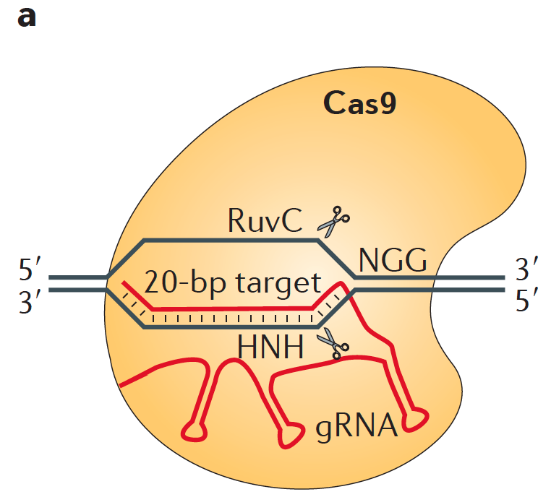

Slide 5
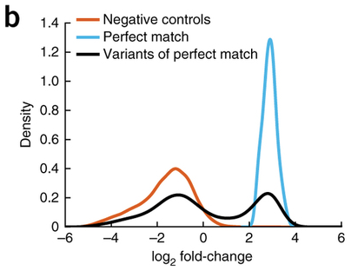

Slide 6
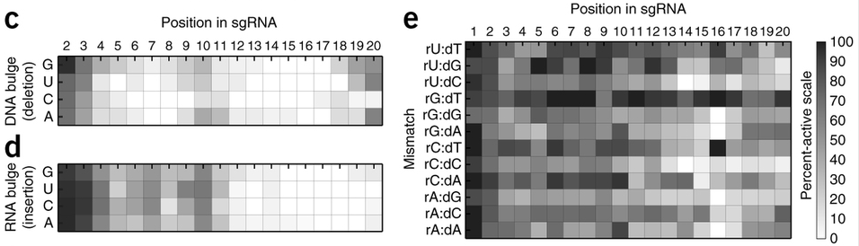

Slide 7
Coding
Propose a tool that finds PAM sites in the human reference genome as well as Carl’s genome and compares the similarity of the two sets.

Slide 8
Coding: Approach
Data I/O
Find PAM Sites
Compare Sets

Slide 9
Coding: Approach
Data I/O
SubjectZ’s genome is aligned against hg37
Read in .fa files for Z and reference genome
Find PAM Sites
Look for 5’-NGG-3’ and 3’-CCN-5’ motifs on each chromosome (store in list)
Compare Sets
Append 20 NTs upstream for specificity
Find intersection of Z and reference PAM+gRNA sequences
Divide by length of reference set

Slide 10
Coding: Implementation
Data I/O
R Bioconductor BioString package
Find PAM Sites
BioString methods for memory-optimized pattern searching
Compare Sets
Subsample first 1000 reference PAM sites and first 1000 Z PAM sites per chromosome to alleviate runtime and memory constraints

Slide 11
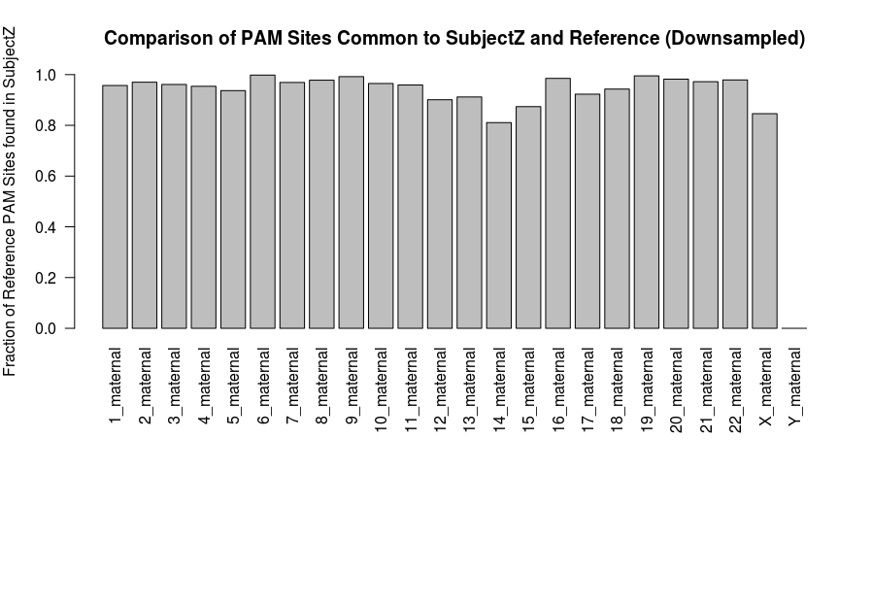
Coding Results

Slide 12
Conclusions
Subject Z’s genome seems to have most PAM sites preserved
The method presented here underestimates preservation because CRISPR does not require perfectly matched guides
Downsampling to 23,000 PAM sites (from several million) is likely to bias results

Slide 13
Pipeline
Calculate the sgRNA libraries for the reference genome and Carl’s genome. How different are these two sets?

Slide 14
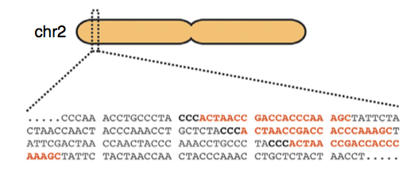
Goal of pipeline:
Generate single guide RNA (sgRNA) libraries from Carl’s genome and compare it to the reference genome
Two genome files for Carl: maternal and paternal
One reference genome: 37

Slide 15
GuideScan Software Implementation
Dependencies:
samtools==1.3.1
pysam==0.8.3, pyfaidx==0.4.7.1, bx-python==0.7.3
biopython>=1.66
Sklearn==0.16.1

Slide 16
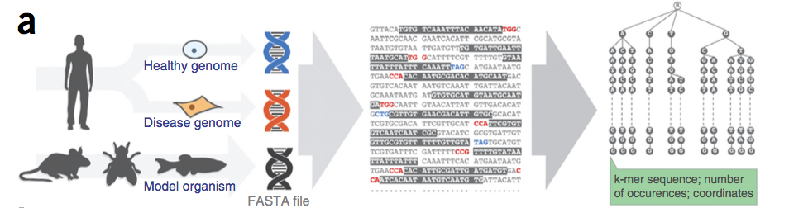
GuideScan: Inputs
.fasta (or .fa) file of genome
gRNA sequence length (20 – 100 bases, excluding PAM site)
Alternative PAM sequence
Chromosomes (list, comma separated)
Min and Max allowed mismatches for off-target statistics
Perez et. al., Nature Biotechnology, 2017

Slide 17
GuideScan: Inputs and Outputs
Outputs:
Target site coordinates (start and end)
sgRNA sequence
For a given sgRNA:
Off target sites, gRNA sequence, (M:N_{M}|Q:N_{Q} )
M = number of allowed mismatches (min) within gRNA sequence to be considered the gRNA, N_{M} is the number of times it occurs
Q = number of mismatches to sequence to be considered off-target site, N_{Q} is the number of occurances
Cutting efficiency score, specificity score for ea. OT site

Slide 18
Our sgRNA Libraries
Zimmer_mom
Zimmer_dad
Human reference genome 37
Chromosome 18
20 base-long gRNA sequences
Canonical PAM sequence NGG
~5.75 M gRNA for each

Slide 19
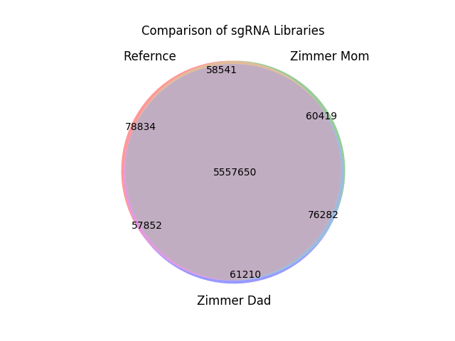

Slide 20
What we found
Unique to each library:
Mom: 1.05% of 5,752,892
Dad: 1.06% of 5,752,994
Ref: 1.37% of 5,752,877
5.557 M gRNAs in common

Slide 21
What we found
Maternal-Reference:
58,541
Paternal-Reference:
57,852
Maternal-Paternal
76,282
Zimmer mom and dad have slightly more in common than with either does with the reference.

